Slide 1

Susquehanna Workforce Innovation Partnership (SWIP)
Quarterly Meeting
August 13, 2019
Quarterly Meeting
May 8, 2018

Slide 2

Agenda
2:00 Introductions
    “What did you read this summer?”
2:10 Calibrating to new program year
2:30 Evaluation against State Strategic Goals
3:15 Identifying FY2020 Activities
3:45 Next Steps for SWIP

Slide 3
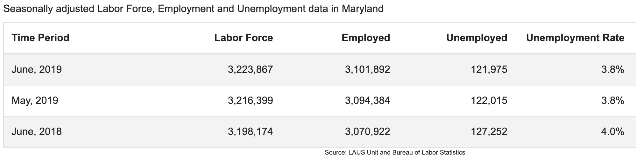
Labor Market Update - Maryland

Slide 4
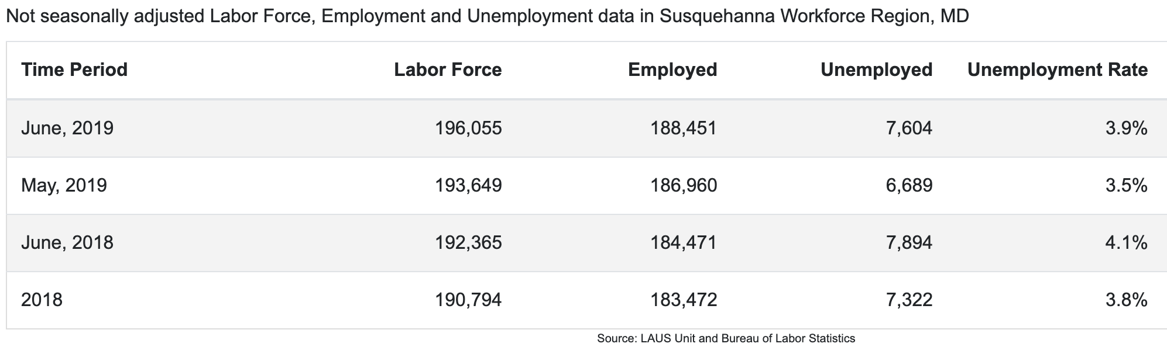
Labor Market Update - Susquehanna

Slide 5
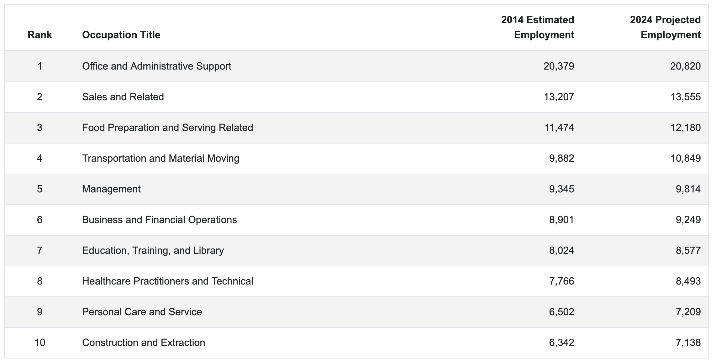
Labor Market Update - Susquehanna

Slide 6

Workforce System Partners Updates
The Transitional Support Services (TSS)
Program purpose: to assist families with their transition from welfare to work as it lessens the effect of the benefit cliff immediately upon obtaining employment
Program implementation date: July 1, 2019; first TSS payment August 2019
The TSS benefit provides financial assistance to customers whose TCA case is closed due to over scale earned income or a combination of earned and unearned income
Eligible customers will receive 3 consecutive months of TSS benefits, which is equivalent to the last TCA payment received
Notes:
SWN Job Centers
Youth
Business Services
DORS
HCC
Cecil
DLLR
DSS – Harford, Cecil
SSA-I

Slide 7
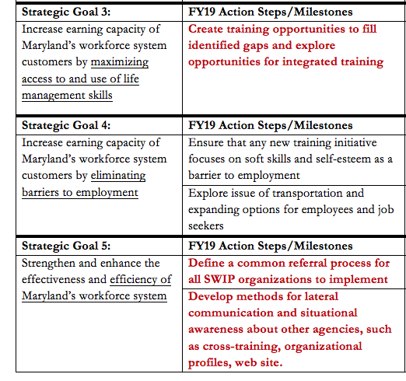
2018-2019 Workforce System Recap
Created Action Plan mapped to state benchmarks
August 2018 SWIP Meeting in Cecil County focused on evaluation and planning
Also worked to:
Strengthen core group
Improve SWIP quarterly meetings
Expand and complete career pathways
Notes:
Objective is to create strategy- and decision-making cohort to guide workforce system resources and initiatives
Biannual meetings in August and February that coincide with MOU renewal cycle
Asked for input on resource allocation process and attendant benefits: Are you getting valuable bang for your buck?

Slide 8
Quarterly SWIP Meetings
November 2018 in Harford County – Transportation Resources and Programs
  Suzanne Kalmbacher, Chief of Cecil Transit
  Steve Overbay, deputy director of Harford County Office of Community and Economic Development
  Gary Blazinsky, transit administrator for Harford County
  Small Group work
February>March 2019 in Cecil County – Employment for Seniors
  Christine Garland, Vice President of Workforce Development, Senior Service America, Inc.
  Karen Y. Winkowski, Harford County Office of Aging
  Small Group work
May 2019 in Harford County – Metrics and Measures
  Eligibility and performance measures
  Alignment with State benchmarks
  Small Group work

Slide 9

Develop Career Pathways
Overarching goal: Create a tool that SWIP stakeholders can use to help clients enter the workforce in sectors that offer opportunities for career advancement
FY18: Developed prototype career pathway for healthcare sector
FY19 goal: Develop pathways for four high-demand sectors: manufacturing, logistics, information technology, and construction
FY20 goals: Solicit industry feedback. Migrate tool from PDF files to web-based and add functionality. Analyze other sectors
9

Slide 10
Health Care Career Pathways (Through Partner Providers Cecil College and Harford Community College)
Healthcare Career Pathways
Field of Work/ Division
Medical Therapeutics
Health Informatics
Rehabilitation Services
Dental Hygienist
Registered Nurse (BS)
Senior-Level
Medical/Health Service Manager
Physical Therapist
Occupational Therapist
$75k-105k
Nurse Practitioner
Registered Nurse
Mid-Level
Paramedic
Medical Assisting
Licensed Practical Nurse
Medical Insurance Billing
Health Information Technologist
$36k-60k
Personal Trainer
Physical Therapist Assistant
Emergency Medical Technician
Dental Assistant
Phlebotomist
Medical Admin Assistant
Physician Professional Coder
Entry Level
Pharmacy Technician
Certified Medicine Aide
$25k-35k
Physical Therapy Technician
Certified Medical Assistant
Certified Nursing Assistant
Zone I Careers
Zone 2 Careers
Zone 3 Careers
Zone 4 Careers
10

Slide 11
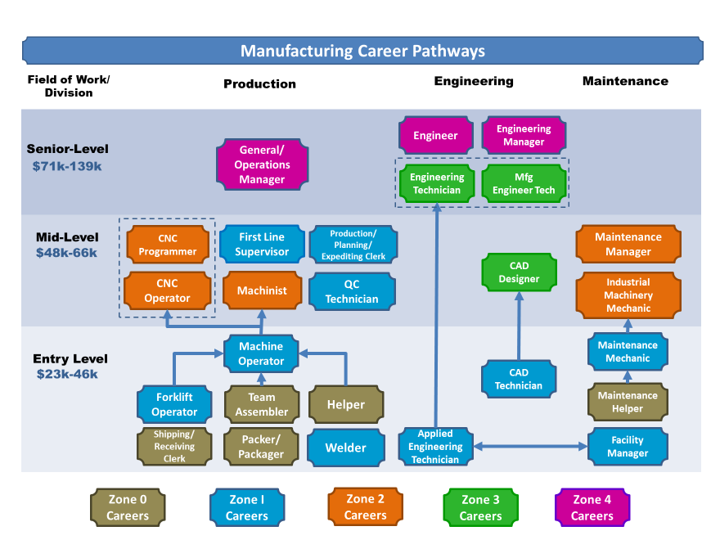
11

Slide 12
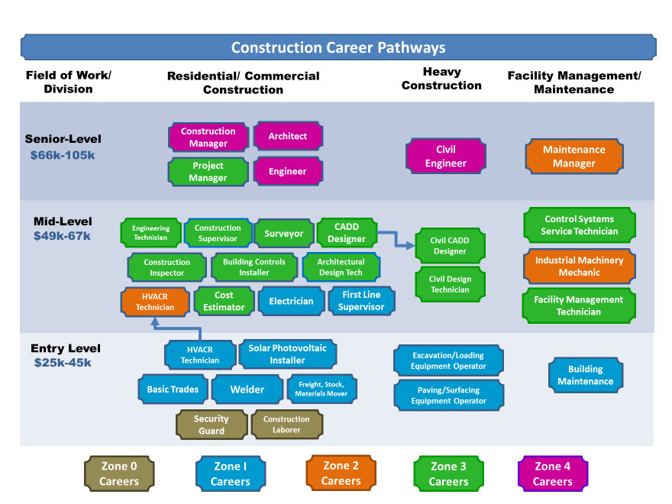
12

Slide 13
Warehouse/Logistics Career Pathways (DRAFT)
Field of Work/ Division
Operations
Drivers/ Operators
Maintenance
Logistics
General/ Operations Manager
Industrial Engineer
Buyer/ Purchasing Agent
Senior-Level
$71k-139k
Transportation Manager
First Line Supervisor
Mid-Level
First Line Supervisor
Production/ Planning/ Expediting Clerk
Heavy/ Tractor-Trailer (CDL A)
Maintenance Manager
Cargo/ Freight Agent
$48k-66k
Bus/Truck Mechanic
Dispatcher
Inspector/ Tester
Forklift Operator
Light Truck (CDL B)
Maintenance Mechanic
Order Clerk
Entry Level
$23k-46k
Helper
Machine Operator
Maintenance Helper
Stock Clerk
Bus Driver (CDL B)
Team Assembler
Packer/ Packager
Janitor/ Cleaner
Shipping/ Receiving Clerk
Zone 0 Careers
Zone I Careers
Zone 2 Careers
Zone 3 Careers
Zone 4 Careers

Slide 14
Information Technology Career Pathways (DRAFT)
Field of Work/ Division
Programming/Development
Systems
Database
Support
QA Analyst/ Tester
Info Security Analyst
Senior-Level
$72k-146k
Applications Developer
Network Architect
Info Systems Manager
Database Admin
Support Manager
Technical Writer
Systems Software Developer
Network/ Systems Admin
Network/ Systems Analyst
Programmer
Network Support Specialist
Cyber-Security Intern
Network/ Systems Analyst (Jr)
Database Admin (Jr)
Training Specialist
QA Analyst/ Tester (Jr)
Network/Sys Admin (Jr)
Support Specialist Level 2-3
Web Developer
Mid-Level
Stock/Office Clerk
Support Specialist Level 1
Entry Level
IT Internships
Computer Repair
$42k-71k
Programmer (Jr)
$23k-41k
Data Entry Keyer
Zone 0 Careers
Zone I Careers
Zone 2 Careers
Zone 3 Careers
Zone 4 Careers
14

Slide 15


Create lateral communication tools

Slide 16
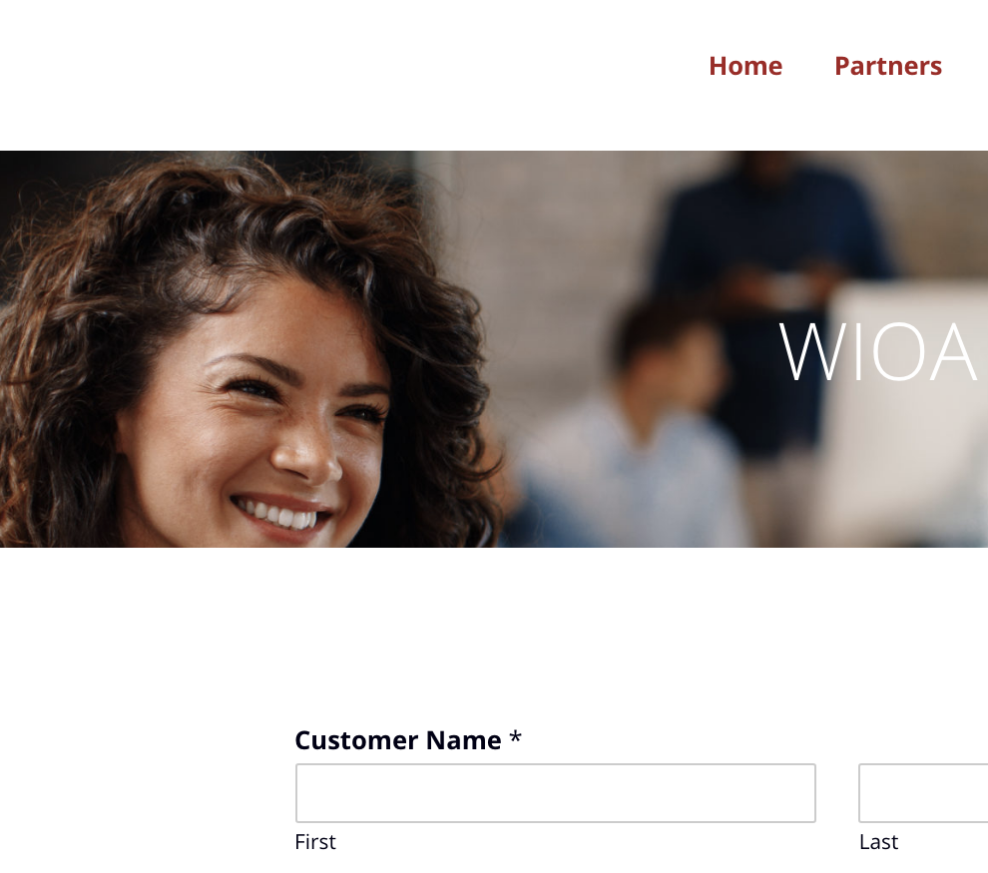
Create a common referral form and process
Number of referral among agencies is State measure of workforce system health
No partners currently track
“Low-hanging fruit”

Slide 17

Initiatives carried over into 2020
Complete programming of career pathways
Improve programming of referral form and functionality
Work to integrate new tools into each agency’s workflow
Add quarterly workshops for workforce partners on topics that tighten integration of system and improve service to customer
Begin new state system metrics collection

Slide 19

Evaluation Against State Strategic Goals
Maximize Access to:
Employment
Skills and Credentialing
Life Management Skills
Resources to remove barriers

Slide 20
Action Plan for 2020

Slide 21
Action Steps for 2020
Strengths-Opportunities: How can we use internal strengths to go after external opportunities?
Strengths-Threats: How can we use our internal strengths to minimize threats
Weakness-Opportunities: How can we improve our weaknesses by taking advantage of opportunities
Weakness-Threats: How can we eliminate/mitigate weaknesses to avoid threats

Slide 22
Next Steps for SWIP
FY2020 Calendar
August 13, 2019, 2-4 p.m. SWIP Meeting, Cecil County
September 20, 2019, 1-4 p.m. Skills Workshop #1
October 25, 2019, 1-3:00 p.m. Cross-Training for Staff
November 12, 2019, 2-4 p.m. SWIP Meeting, Harford County
December 6, 2019, 1-4 p.m. Skills Workshop #2
January 17, 2020, 1-4 p.m. Skills Workshop #3
February 11, 2020, 2-4 p.m. SWIP Meeting, Cecil County
March 22, 2020, 1-4 p.m. Skills Workshop #4
April 19, 2020, 1-3 p.m. Cross Training for Staff
May 12, 2020, 2-4 p.m., SWIP Meeting, Harford County
June 21, 2020, 7 a.m. Workforce Recognition at Annual Meeting
Topics for SWIP discussion
Youth services
Financial literacy
Industry panel
Child care

Slide 23

Training Topics
Generation Gap
Influence and Persuasion
Communication
Managing Press
Anger Management
Body Language
Dealing with Difficult People
Project Management
Motivation
Working Smarter
Customer Service
Facilitation Skills
Business Writing
Conquering Public Speaking
Dynamic Presentations
Social Media
Crisis Management
Marketing and Sales
Team Building
Digital Transformation
………………..

